Slide 1
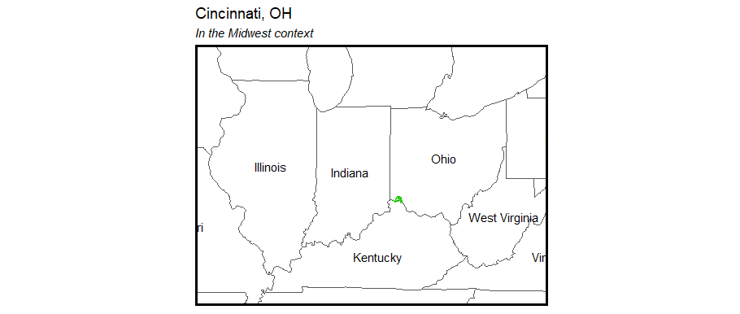

Heroin Overdoses in Cincinnati, Ohio
Claire Allen-Platt and Nicolas Corona

Slide 2
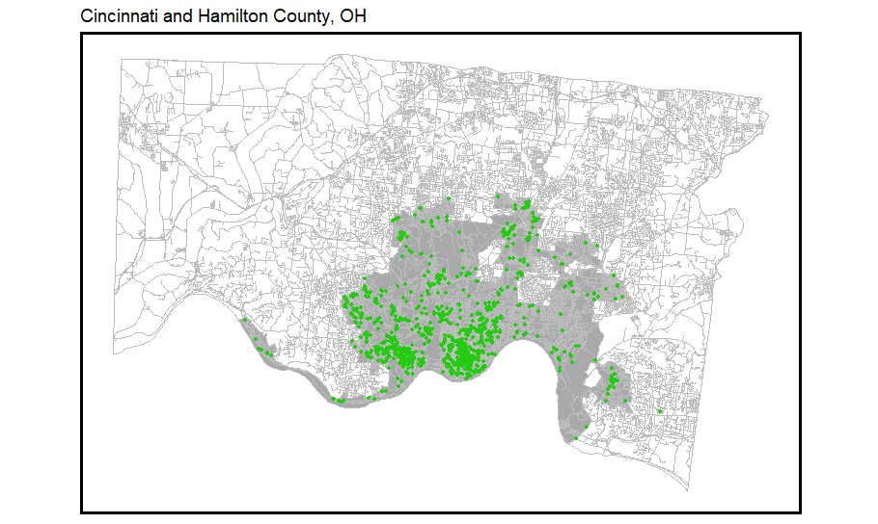
Problem
Midwest
In 2017, Ohio had the second highest opioid overdose rate in the US¹
The city of Cincinnati experienced a 50% rise in opioid overdoses since 2015², with heroin overdoses declared an “epidemic”³
Cincinnati now distributes take-home kits of Narcan through the Narcan Distribution Collaborative (NDC) in 2017
Hamilton County, OH
Cincinnati
Locations of heroin overdose events
¹National Institute on Drug Abuse, 2019; ²Li et al., 2019; ³CincyInsights, 2019

Slide 3
Our Proposed Data-driven Approach
Build a statistical model to predict the latent risk of heroin overdoses
Identify areas in Cincinnati that are high-risk for overdoses
Overdose deaths are hyper-local
Overdose patterns vary over time seasonally
Use the results to identify areas in which to focus the Narcan Distribution Collaborative’s take-home kit distribution and training programs
Notes:
Problem:
Public health: 529 fatal opioid overdoses in 2017, driven by fentanyl
EMS resources: 3065 heroin-related responses in 2017
Mayor, regarding 2016: “first responders have gone to about 1,600 overdose runs this year so far, yielding a $1.6 million cost so far for EMS services.” Naloxone breaking the bank.
Business as usual

Slide 4
Data
Outcome of interest: EMS calls either caused explicitly in response to a heroin overdose call or that led to the administration of Narcan
Cincinnati Open Data
Crime reports: drug-related crime
311 calls
Code violations
Abandoned homes, etc.
Police calls
Zoning / park boundaries
Census / ACS Data
Racial proportions
Gender distribution (MALE)
Age groups – by gender, too
Poverty / bachelor’s / unemployment

Slide 5
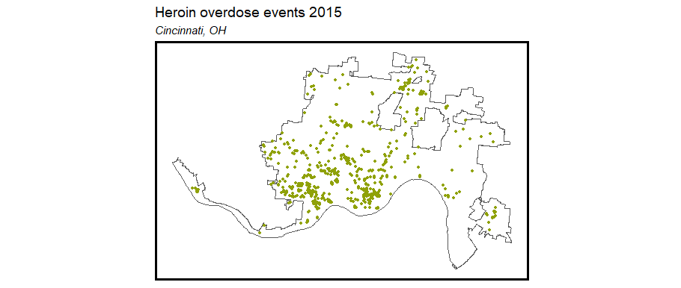
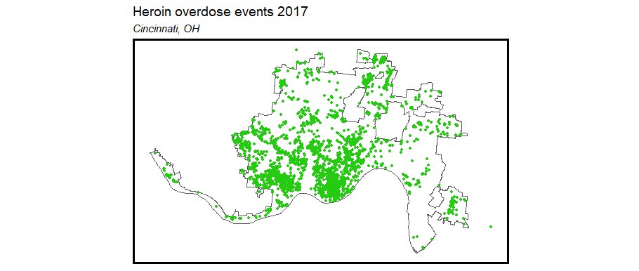
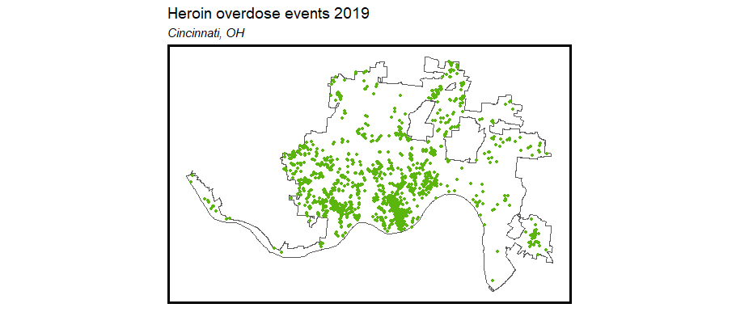
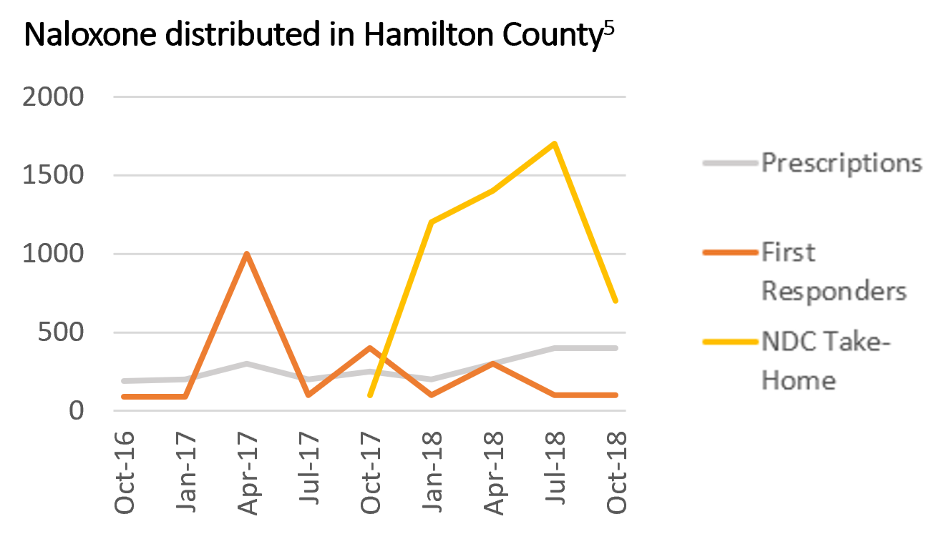
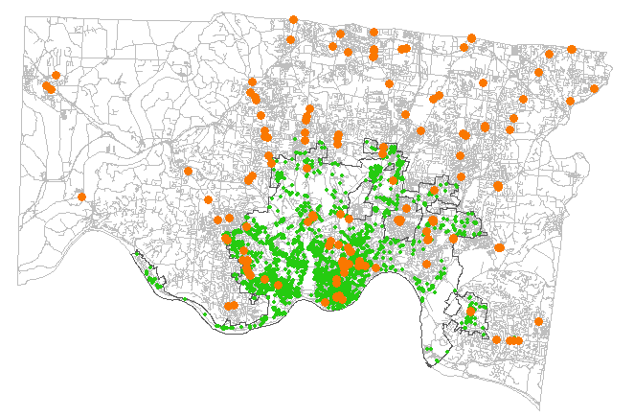
Exploratory Analysis
Heroin overdose events in Cincinnati spiked in 2016-2017 and have begun to decline
2015
2017
2019
Supply versus demand: heroin overdoses
vs. Naloxone distribution sites
Heroin overdose
Naloxone distribution site
⁵Ingram, 2018

Slide 6
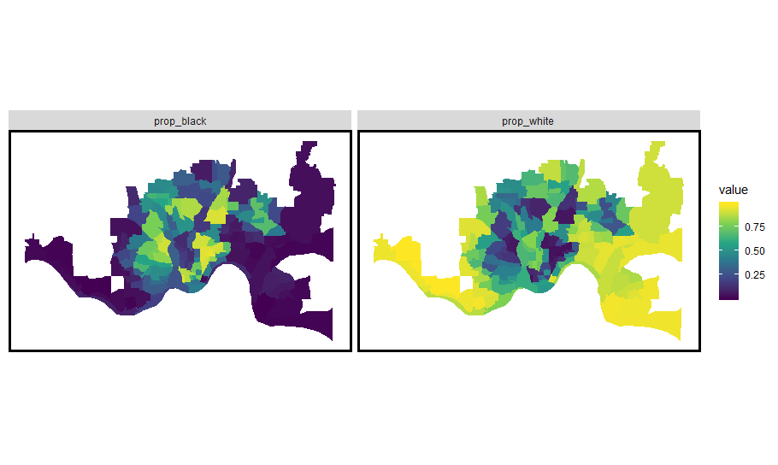
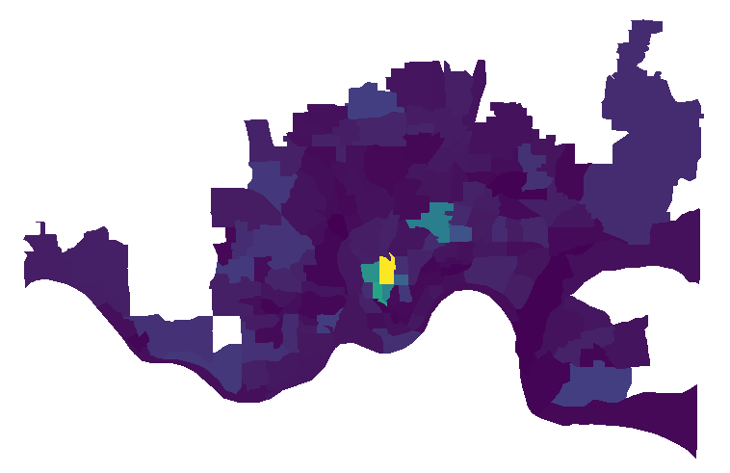
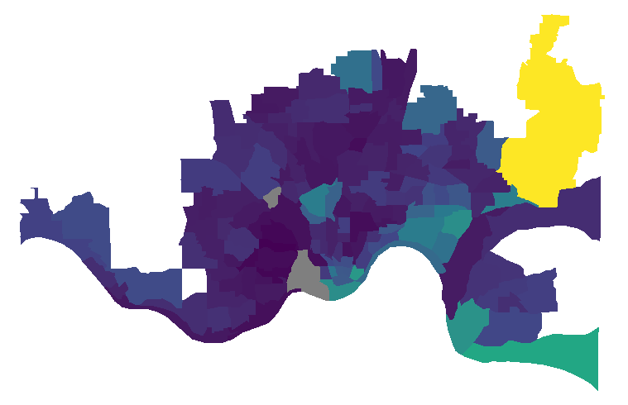
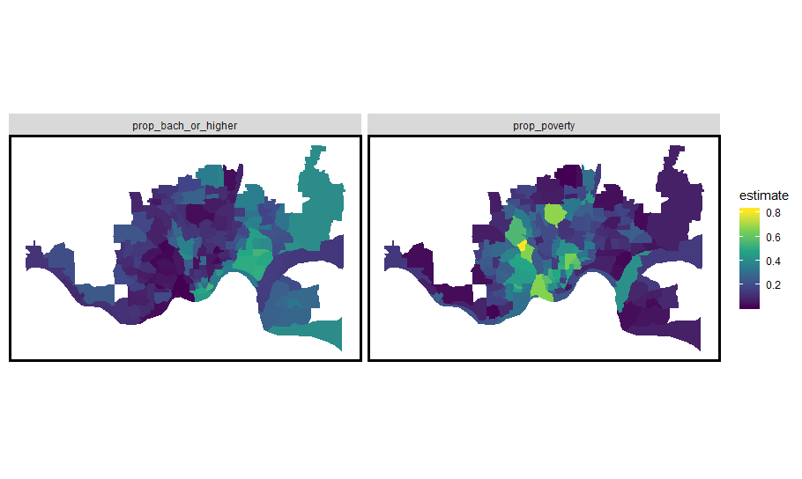
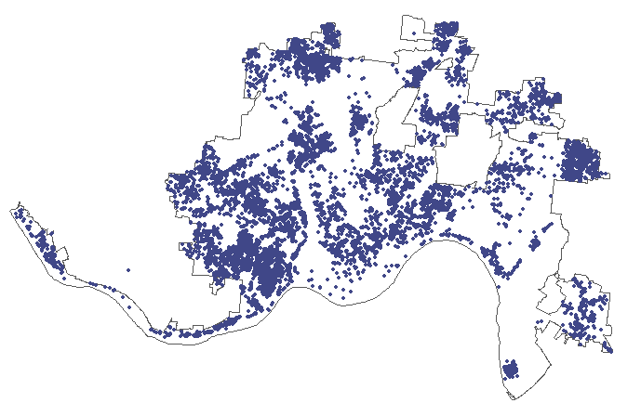
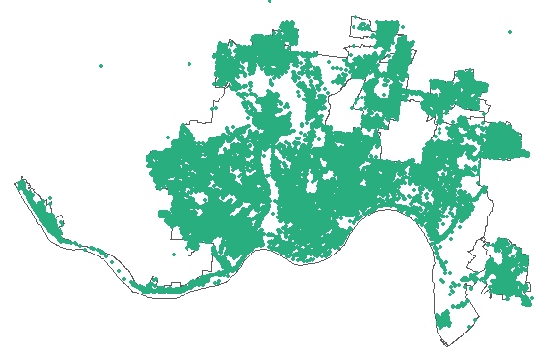
Exploratory Analysis
Proportion Black
Proportion White
Men aged 18-24
Heroin overdose events, 2017
Median home value
Proportion in poverty
Proportion with college degree
Abandoned vehicles
Trash complaints

Slide 7
Model
Poisson regression
Spatial
Train on 2015 – 2018 data (through the parabola trend shape), test on 2019 data
Time-invariant covariates
Census tract data (ACS 2015)
Male population
Racial/ethnic makeup
Median household income
Poverty rate
Neighborhood
Zoning (manufacturing, commercial, residential)
Number of fast food restaurants
Time-varying covariates
Crime
Weather: precipitation and temperature
Seasons: peak in summer, trough in winter

Slide 8
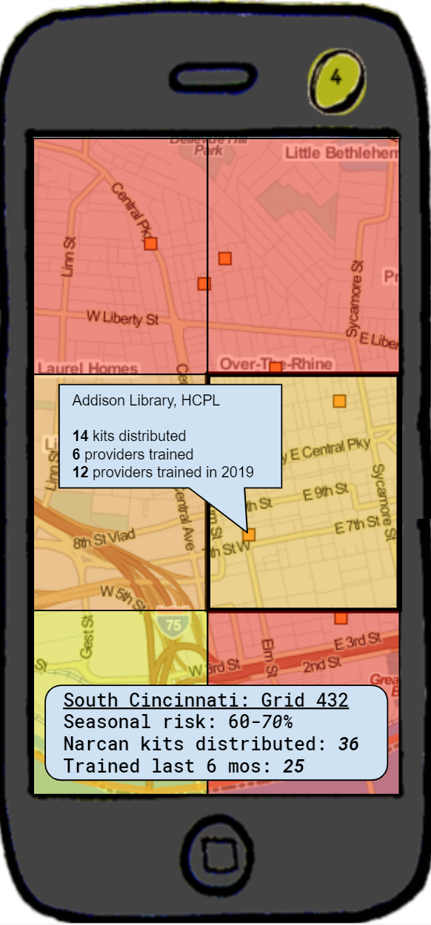
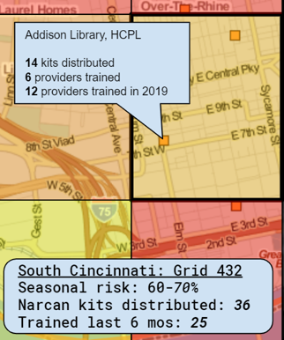
Narcan Distributor
Overlays color-coded risk data on a navigable map
Displays risk assessment and distribution and training data by grid cell
Identifies prior distribution and training sites
Notes:
App called “Narcan Distributor” or “Narcan Mapper”
Functionalities
- Identify at-risk locations and map allocation of home-kits to the public near those locations.
- Identify areas without recent training - app recommends you set up shop for retraining.
- App recommends areas where NDC should set up stands for narcan distribution and training.
- App recommends buildings or locations where people should have narcan and narcan training in hotspot areas (parks, fast food restaurants, etc).
- App maps change in demand over time seasonally and recommends shifting focuses over time.

Slide 9
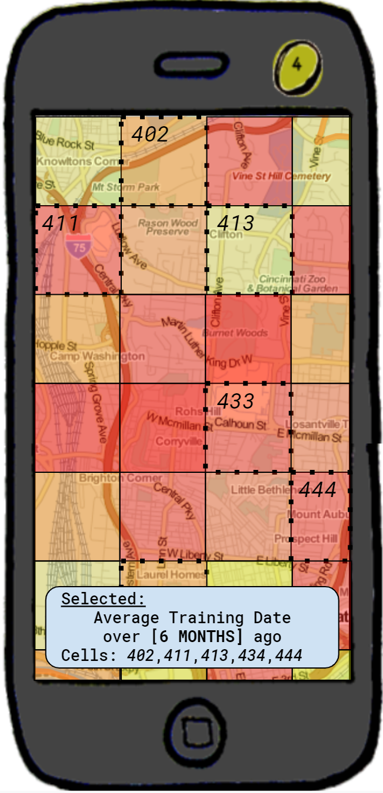
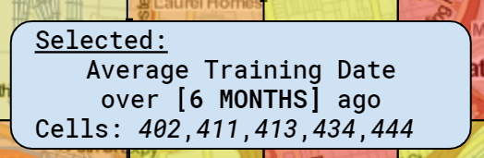
Narcan Distributor
Identifies locations with where risk can be abated with kit distribution and Narcan kit training
Change recommendations over time in response to time-varying factors: season, weather, crime, etc.
Recommends locations (parks, fast-food restaurants, libraries) for direct outreach

Slide 10
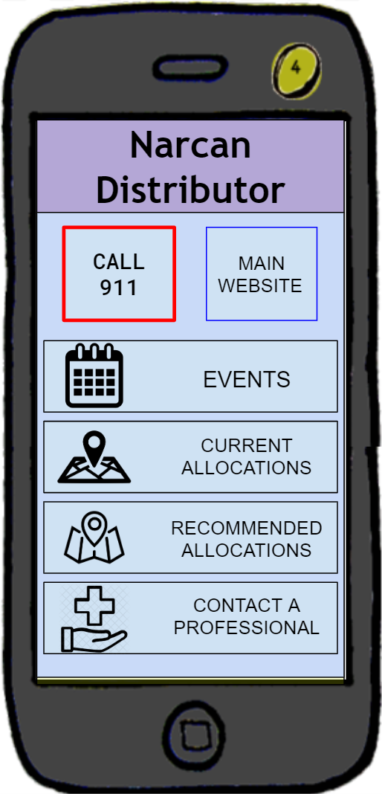
Notes:
In conclusion, the Narcan Distributor app will improve the NDC’s allocation of limited Narcan resources by using a predictive model for latent risk and providing targeted recommendations for future outreach in the city of Cincinnati.

Slide 11
Thank you!

Slide 12
References
Bates, S., Leonenko, V., Rineer, J., & Bobashev, G. (2018). Using synthetic populations to understand geospatial patterns in opioid related overdose and predicted opioid misuse. Computational and Mathematical Organization Theory, 25, pp. 25-36.
CincyInsights. (2019). Heroin overdose responses [webpage]. City of Cincinnati. Accessed from https://insights.cincinnati-oh.gov/stories/s/Heroin-Overdose-Responses/dm3s-ep3u/
Ingram, T. (2018). Narcan distribution collective. Hamilton County Department of Public Health. https://www.naccho.org/uploads/downloadable-resources/49-51-Hamilton-County-Narcan-Distribution-Collaborative.pdf
Li, Z.R., Xie, E., Crawford, F.W., Warren, J.L., McConnell, K., Copple, J.T., Johnson, T., & Gonsalves, G.S. (2019). Suspected heroin-related overdoses incidents in Cincinnati, Ohio: A spatiotemporal analysis. PLOS Medicine, 16(11), pp. 1-15.
National Institute on Drug Abuse. (2019). Opioid summaries by state. Accessed from https://www.drugabuse.gov/drugs-abuse/opioids/opioid-summaries-by-state
Ohio Department of Health. (2017). Ohio drug overdose data: general findings. Accessed from https://odh.ohio.gov/wps/wcm/connect/gov/5deb684e-4667-4836-862b-cb5eb59acbd3/2017_OhioDrugOverdoseReport.pdf

